Slide 1

Political Economy
Dr. Hasan Muhammad Baniamin

Slide 2
Political Economy
The political economy is the study of the interactions of politics and economics.
Politics is the study of power and the economics is the study of the creation and distribution of wealth.
Both power and wealth are closely connected.
So, the understanding of contemporary politics requires an understanding of its pervasive linkages with economics.

Slide 3
Key concepts
Market
Property
Public goods

Slide 4
Market
Not a physical place.
Aggregation of individual’s buying and selling behaviours.
Natural forces of supply and demand.

Slide 5
Property
Ownership of goods and services.
Property rights.
State and property rights.

Slide 6
Public goods
Diffused to all and not individually held.
States hold a monopoly.
Example- national defence, flood control systems, and street lighting

Slide 7
Types of political economies
Three different types of political economies:
  (1) the market economy;
  (2) the command economy; and
  (3) the mixed economy.

Slide 8
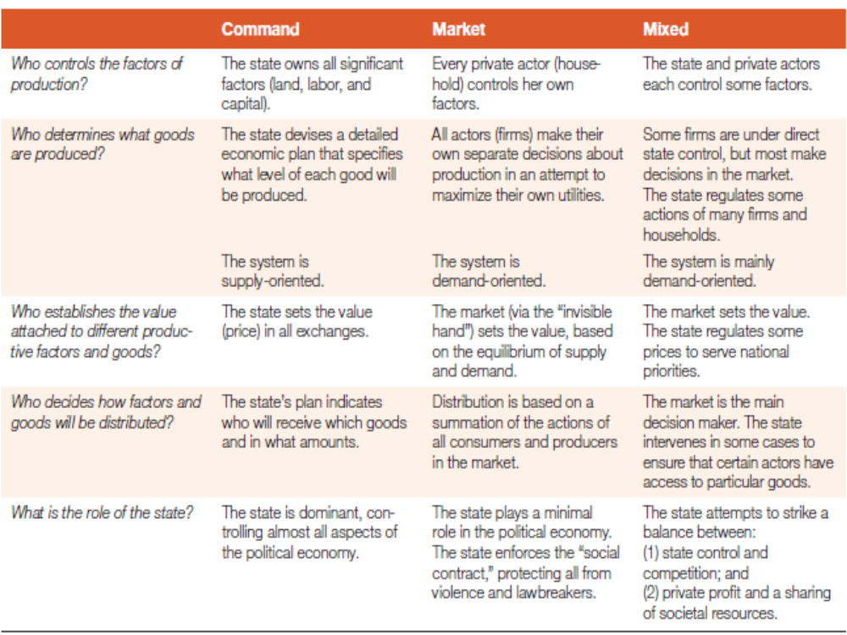
Command, market and mixed political economies

Slide 9
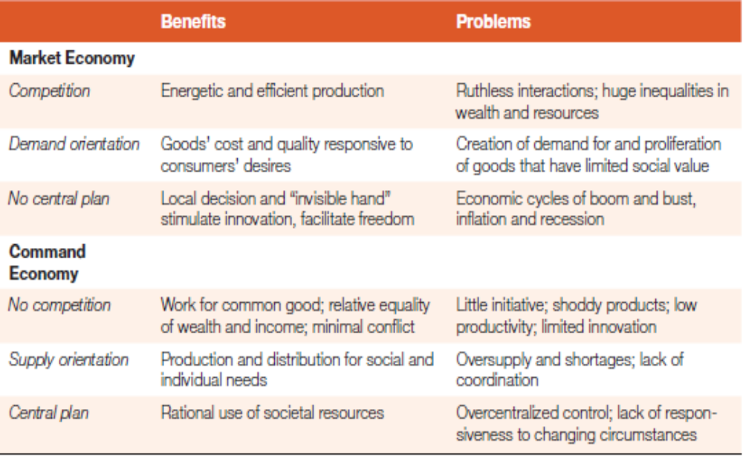
Benefits and Problems of market and command economy

Slide 10
Connections with different ‘isms’
In their most straightforward form, capitalism, communism, and socialism correspond loosely to market economy, command economy, and mixed economy, respectively.
Market economy | Command economy | Mixed economy
Capitalism | Communism | Socialism

Slide 11
Capitalism
Capitalism is a system in which private economic actors are quite free from state constraints, private property rights are fundamental, and the state engages in few actions that might shift resources among private actors. Ex: Switzerland,
It is praised for its economic dynamism, innovativeness, and responsiveness to market demand.
It is criticised as a system of self-interested individualism that denies the need for collective action to protect the disadvantaged, to nurture society as a whole, to promote social values and culture, or to protect the ecology

Slide 12
Communism
Communism has as its centerpiece the socialization of resources—the notion that the state must actively control society’s land, labor, and capital to achieve substantial equality for all citizens. Example- Cuba and the former Soviet Union (1917–1991).
Consistent with the command political economy model, the state guides the utilization of all these major means of production with a central plan so that the production and distribution of goods serve the best interests of the entire population.
Its critics disparage communism as an inefficient economic system with a nondemocratic government that denies individual freedoms and rights.
In recent decades, most countries have abandoned the command economy that is central to communist principles, leading some to suggest that communism is dead.

Slide 13
Socialism
Socialism is in the middle of the two “isms,” and thus it is not precisely differentiated from the other two.
It seeks a complex balance between state involvement and private control of the economy, and a key policy goal is a relatively equitable distribution of benefits to all citizens.
As in the mixed political economy, some major productive resources are owned or controlled by the state, and the state actively intervenes in planning and regulating the economy; but most production decisions are private, and value is stablished primarily by supply and demand.
Socialism is distinguishable from communism because the state only controls a few important factors of production and allows private actors considerable freedom of action.
Finland and Denmark are examples.

Slide 14
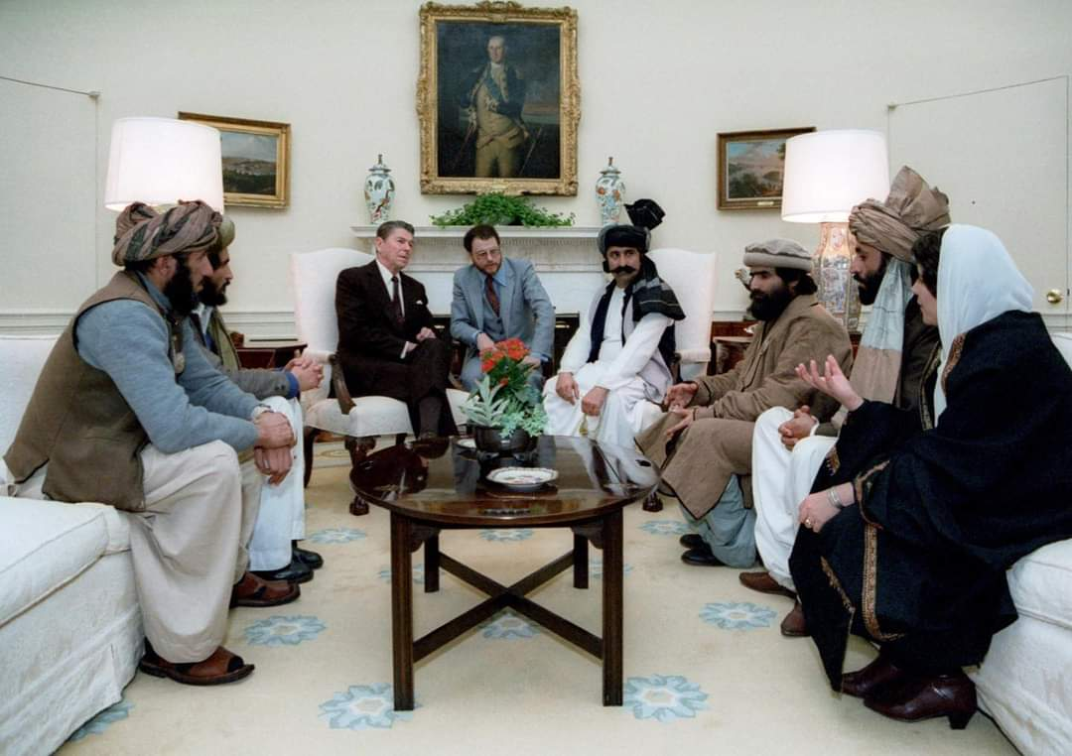
President Reagan meeting with Afghan mujahideen leaders in the Oval Office in 1983

Slide 15
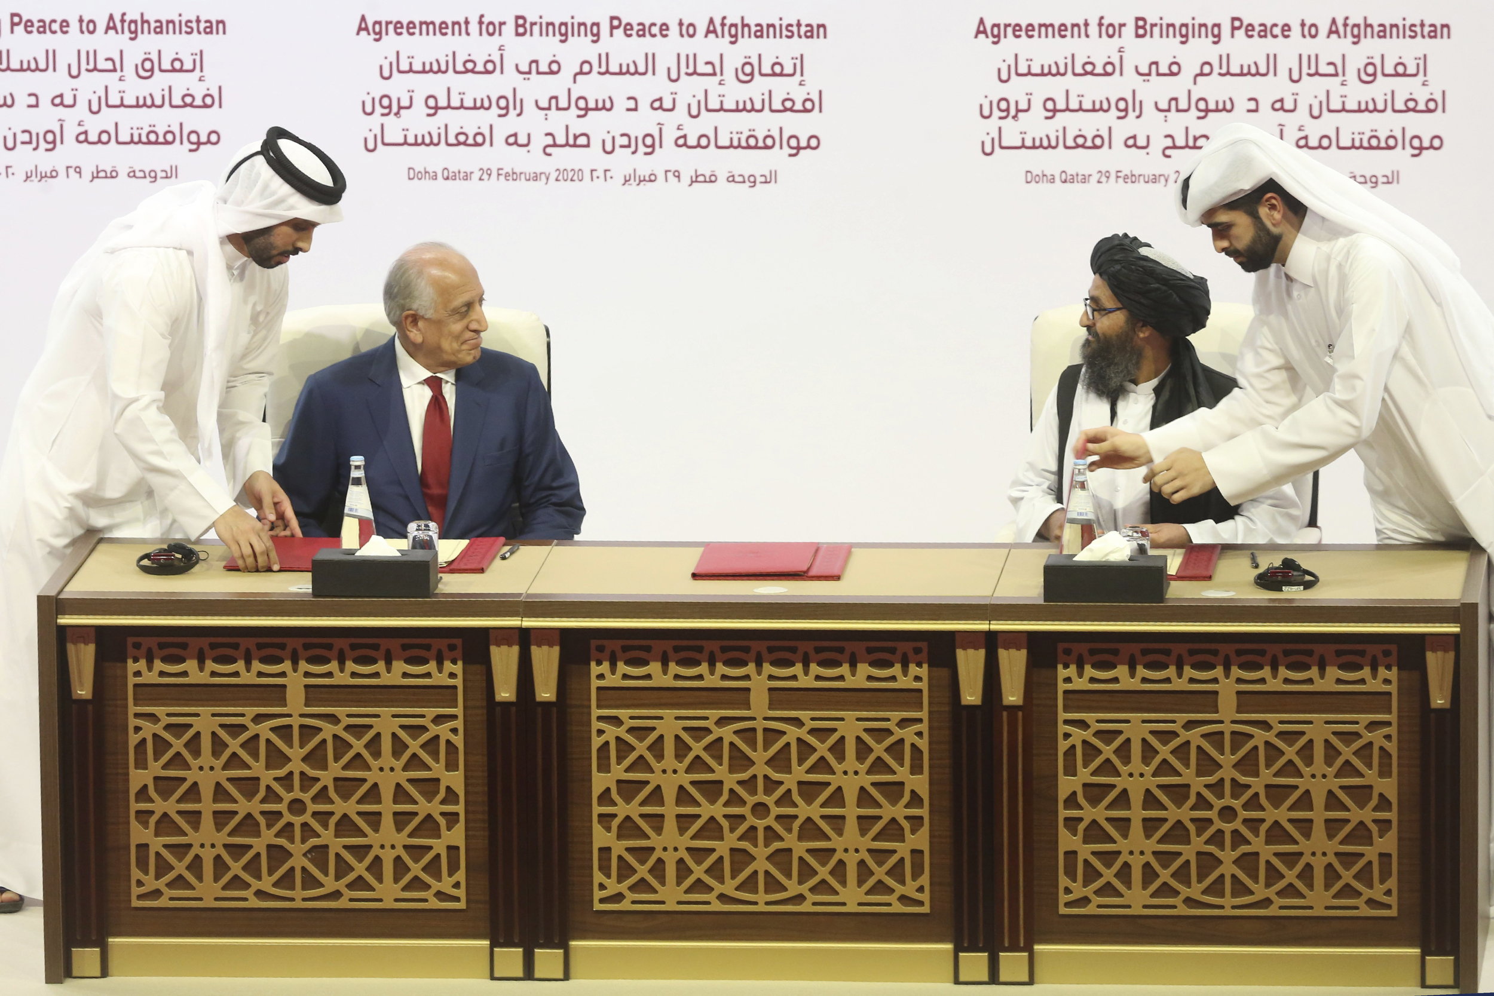

Slide 16
Suggested readings
Danziger, J. N., & Smith, C. A. (2016). Understanding the political world: A comparative introduction to political science. Boston :Pearson, pp. 199-225.

Slide 17
Q?

